Slide 1
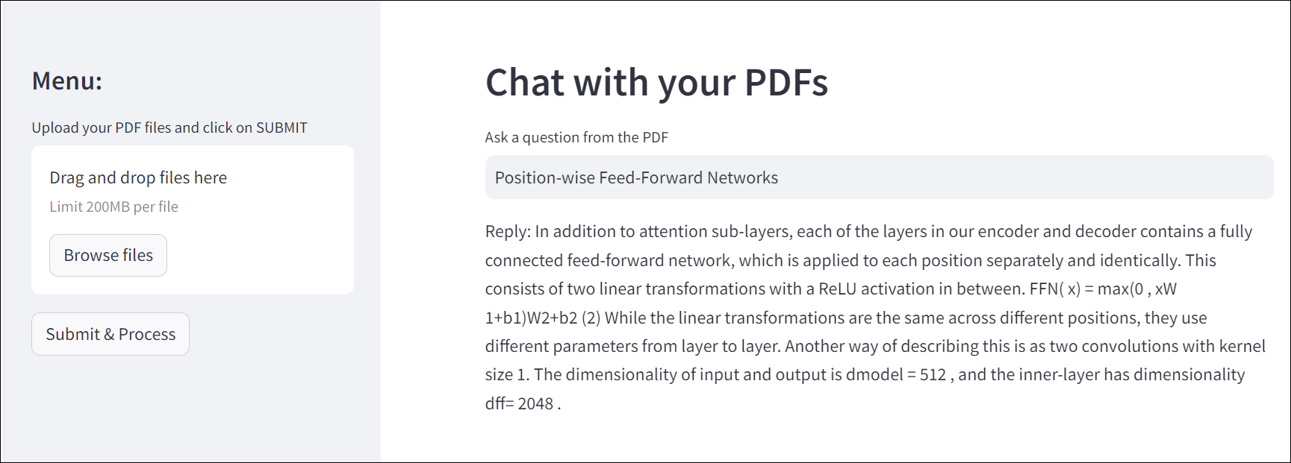
Chat with PDFs

Slide 2
What does the tool do?
Ingest PDF documents upto a size of ~200 Mbs
Learn the contents of the PDF
Response in a human like interaction against the query of the user

Slide 3
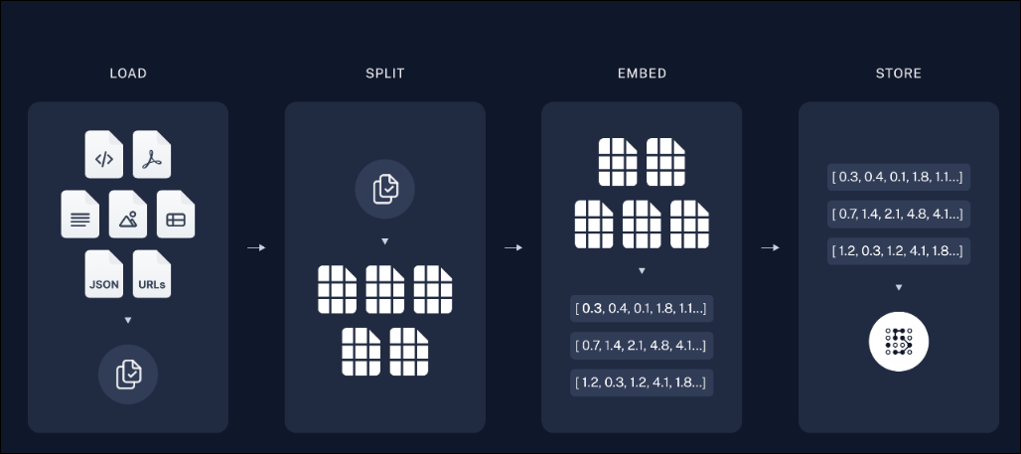
Architecture
Loading and Pre-processing of Text data from PDF
Load multiple PDFs on the tool from local machine
Read the PDF using the PyPDF library of the Python
Split the texts into chunks for each page in each document
Embed the chunks into vectors and store it using FAISS vector store

Slide 4
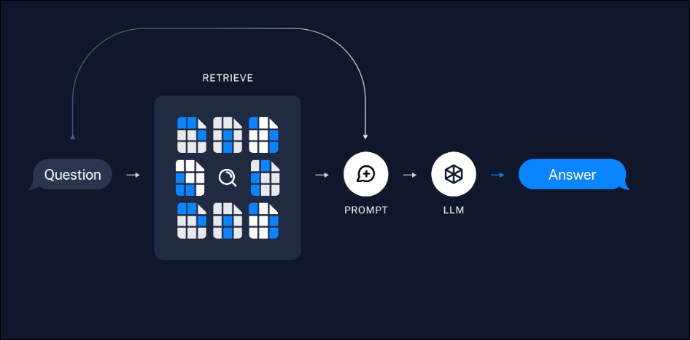
Architecture
Query and Answer using the learned Data
User provides the query in the query bar in the tool
The query is then passed through the FAISS index for similarity search
The relevant information are then passed through a langchain
The langchain here is the prompt + LLM model (gemini-pro)
The response is printed as output

